Slide 1
How many Earths do we need?
A Global Look at Our Ecological Footprint in 2016
Shelby Rathel / May 14th
Notes:
today we’re diving into a simple but powerful question: How many Earths do we need to sustain our lifestyle? We’ll explore global sustainability using 2016 ecological data to understand where we stand, where we’re headed, and what we can learn from countries doing it right.

Slide 2
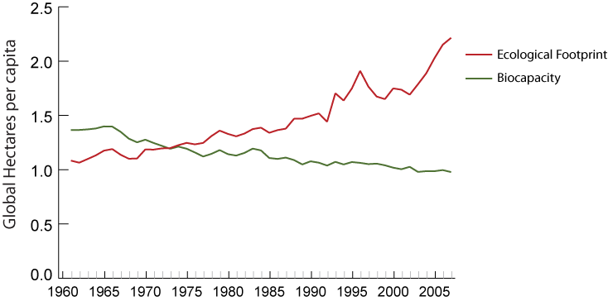
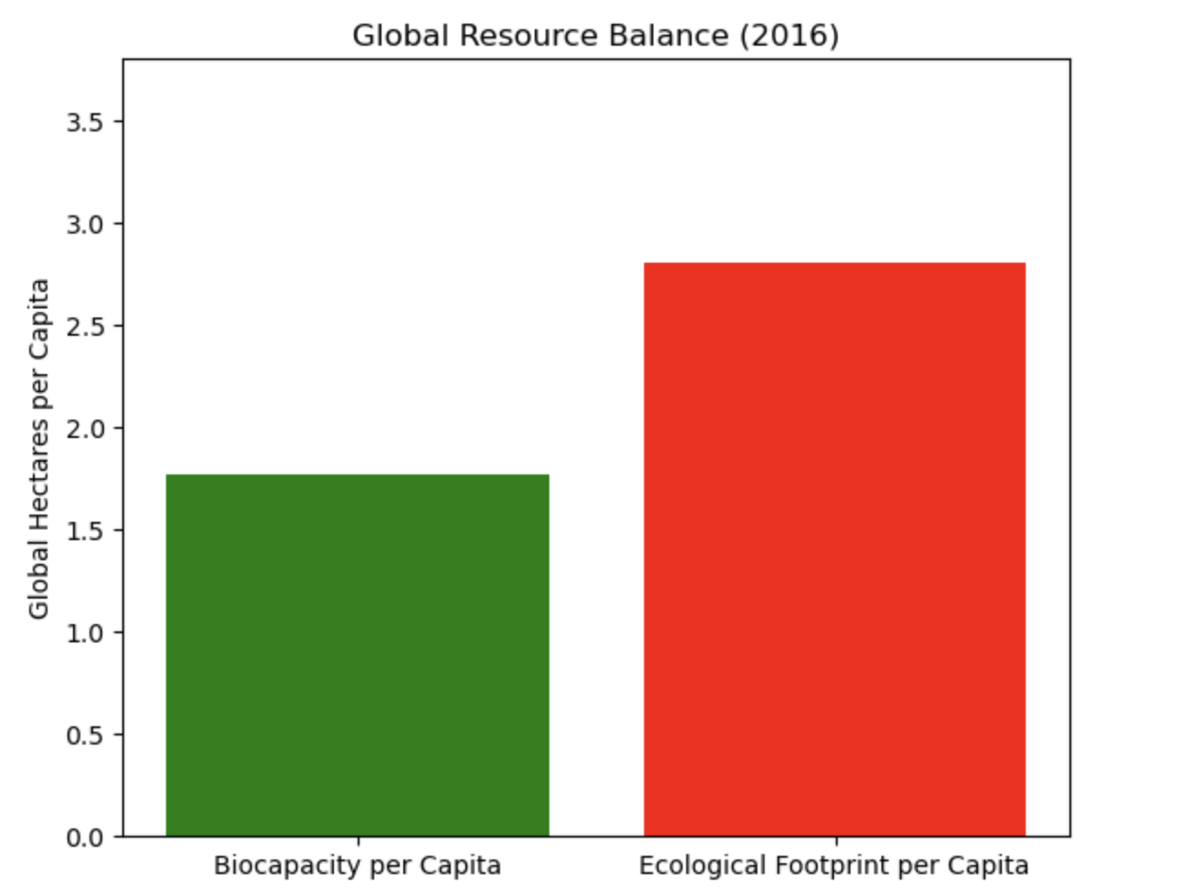

Humanity’s Demand Exceeds Earth’s Supply
Notes:
In fact, we currently consume the resources of about 1.75 Earths every year.
We’ve been running a deficit for over 50 years.
Let’s start with the big picture. Earth provides us with renewable resources—land, forests, water, and energy. But just like a bank account, there’s a limit to what we can spend. Imagine you earn $50,000 a year—but spend $80,000. That’s how the world uses its natural resources. Since around 1970, humanity’s demand for resources has outpaced what Earth can regenerate each year, seen in this chart. In the bar chart, the average person’s ecological footprint in red versus the Earth’s biocapacity in green. Whiich means, In 2016, we were using far more than Earth could regenerate—about 1.7 times more. That’s like spending $1.70 for every $1 you earn—year after year.

Slide 3
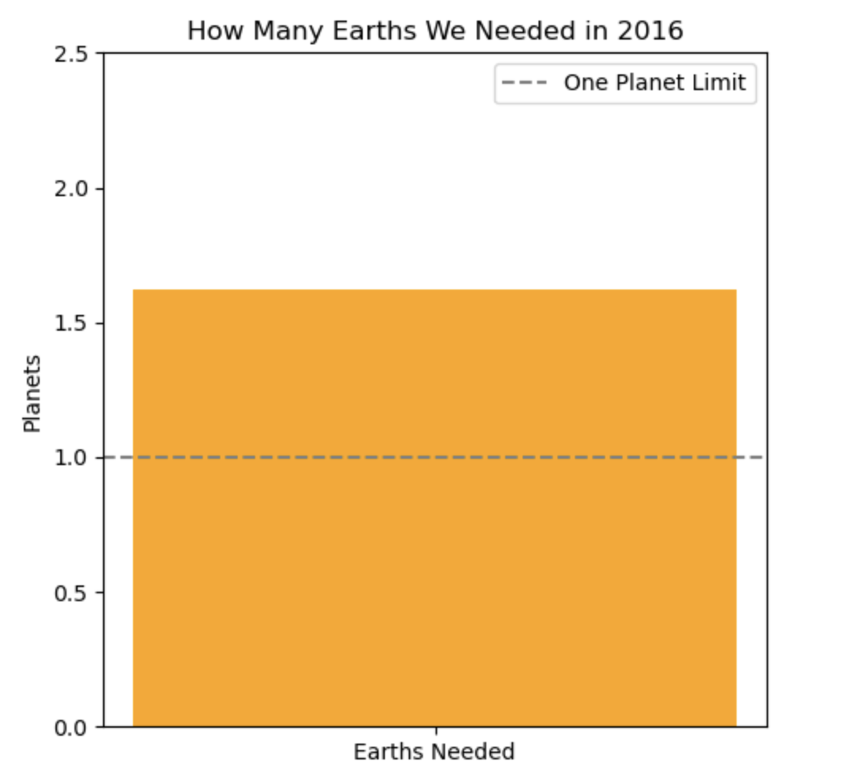
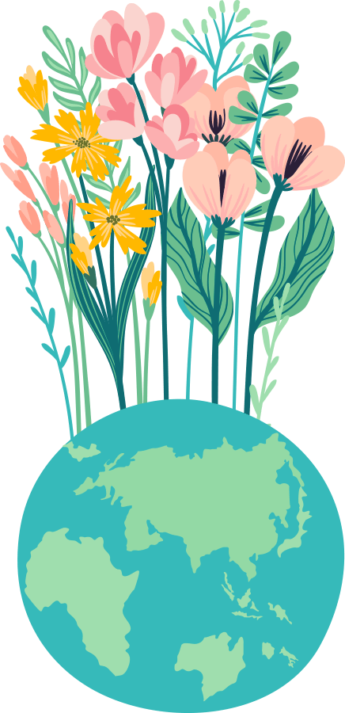
How many Earths did we need in 2016?
Notes:
We can break it down even more. In 2016, humanity needed the equivalent of 1.66 Earths to meet its demand for food, timber, carbon absorption, and other natural services. But we only have one Earth. That means we were depleting our natural capital, not just living off the interest.

Slide 4
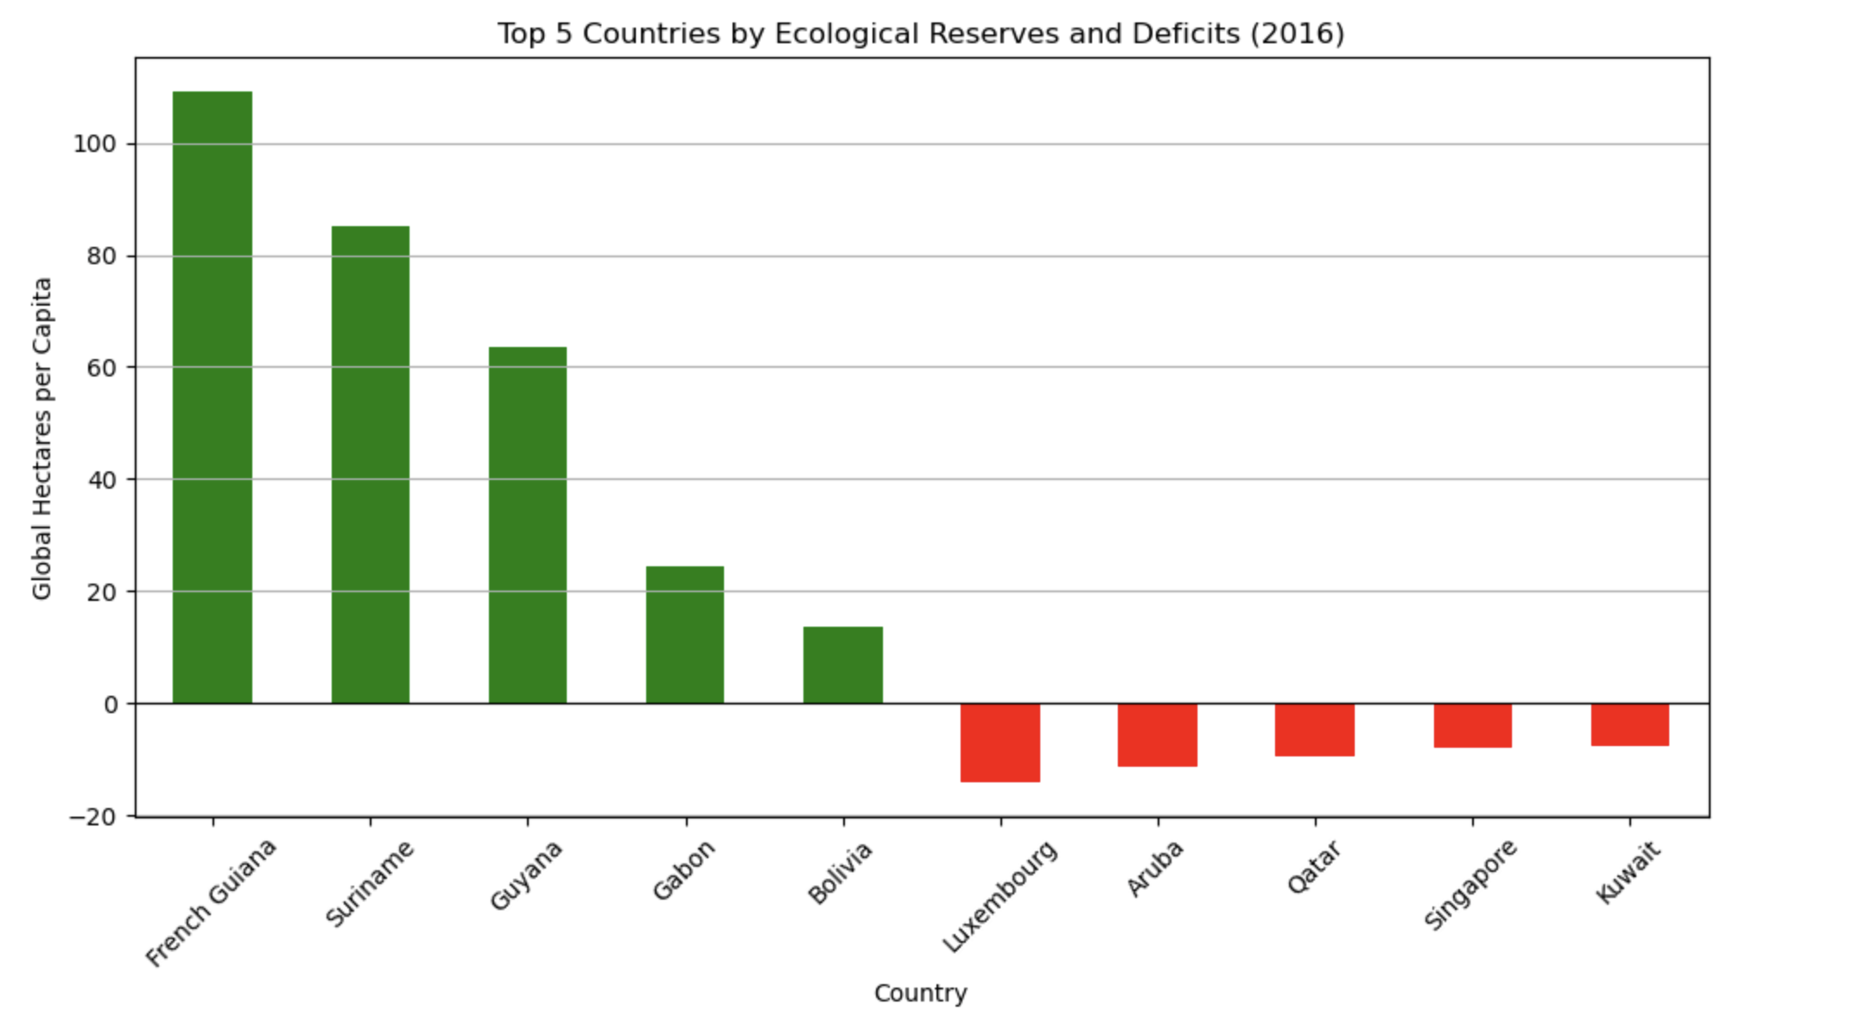

Ecological Reserves vs. Deficits
Notes:
Not all countries are the same. This chart shows the countries with the largest ecological reserves in green—like Canada, Brazil, and Finland—and the countries with the largest deficits in red—like the U.S., UAE, and Japan. Reserves happen when a country produces more natural resources than it uses. Deficits occur when consumption outpaces regeneration.

Slide 5
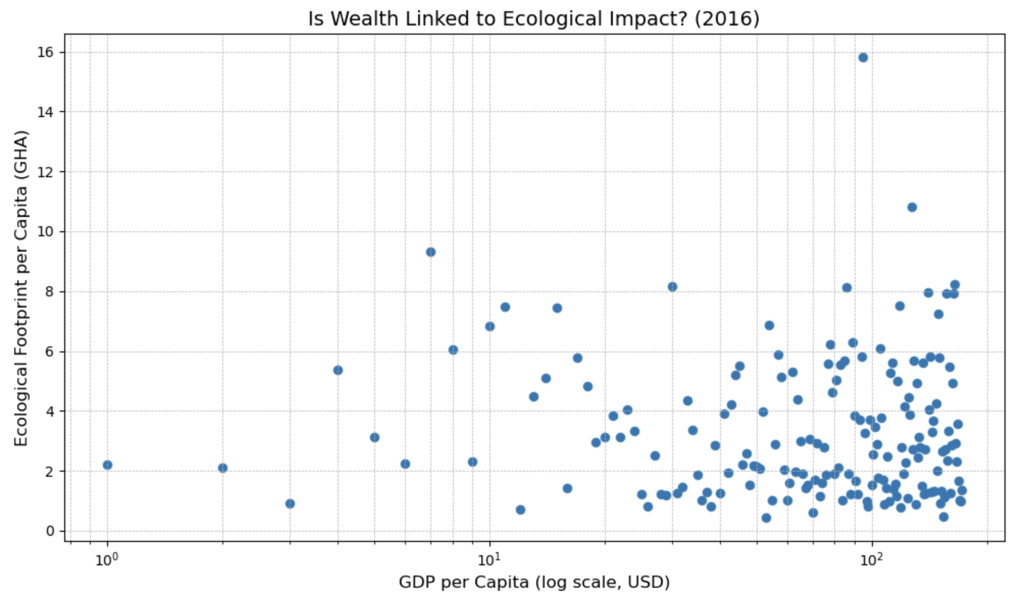
Is It Wealth? Or Population?
Notes:
So what’s driving this imbalance? It’s tempting to blame population alone, but this chart shows GDP per capita versus ecological footprint per person. The trend is clear: wealthier countries tend to consume more resources per person. It’s not just how many people live in a country—it’s how people live.

Slide 6
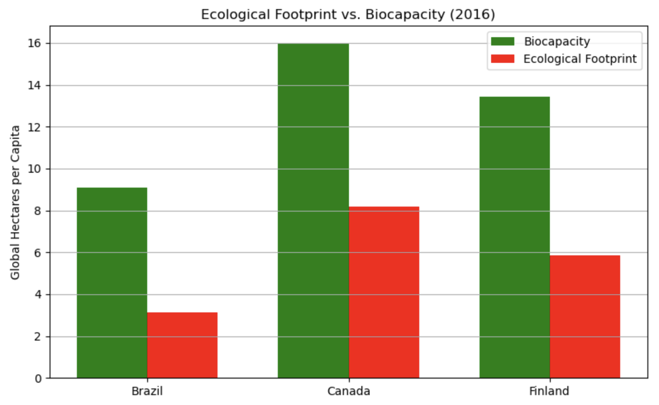
Who’s Doing It Right?
Notes:
Some countries, however, are managing sustainability well. Here we compare Finland, Canada, and Brazil—all with ecological reserves. These countries benefit from large forests, protected ecosystems, and in some cases strong environmental policies. They show that living sustainably is possible with the right balance of population, policy, and preservation.

Slide 7
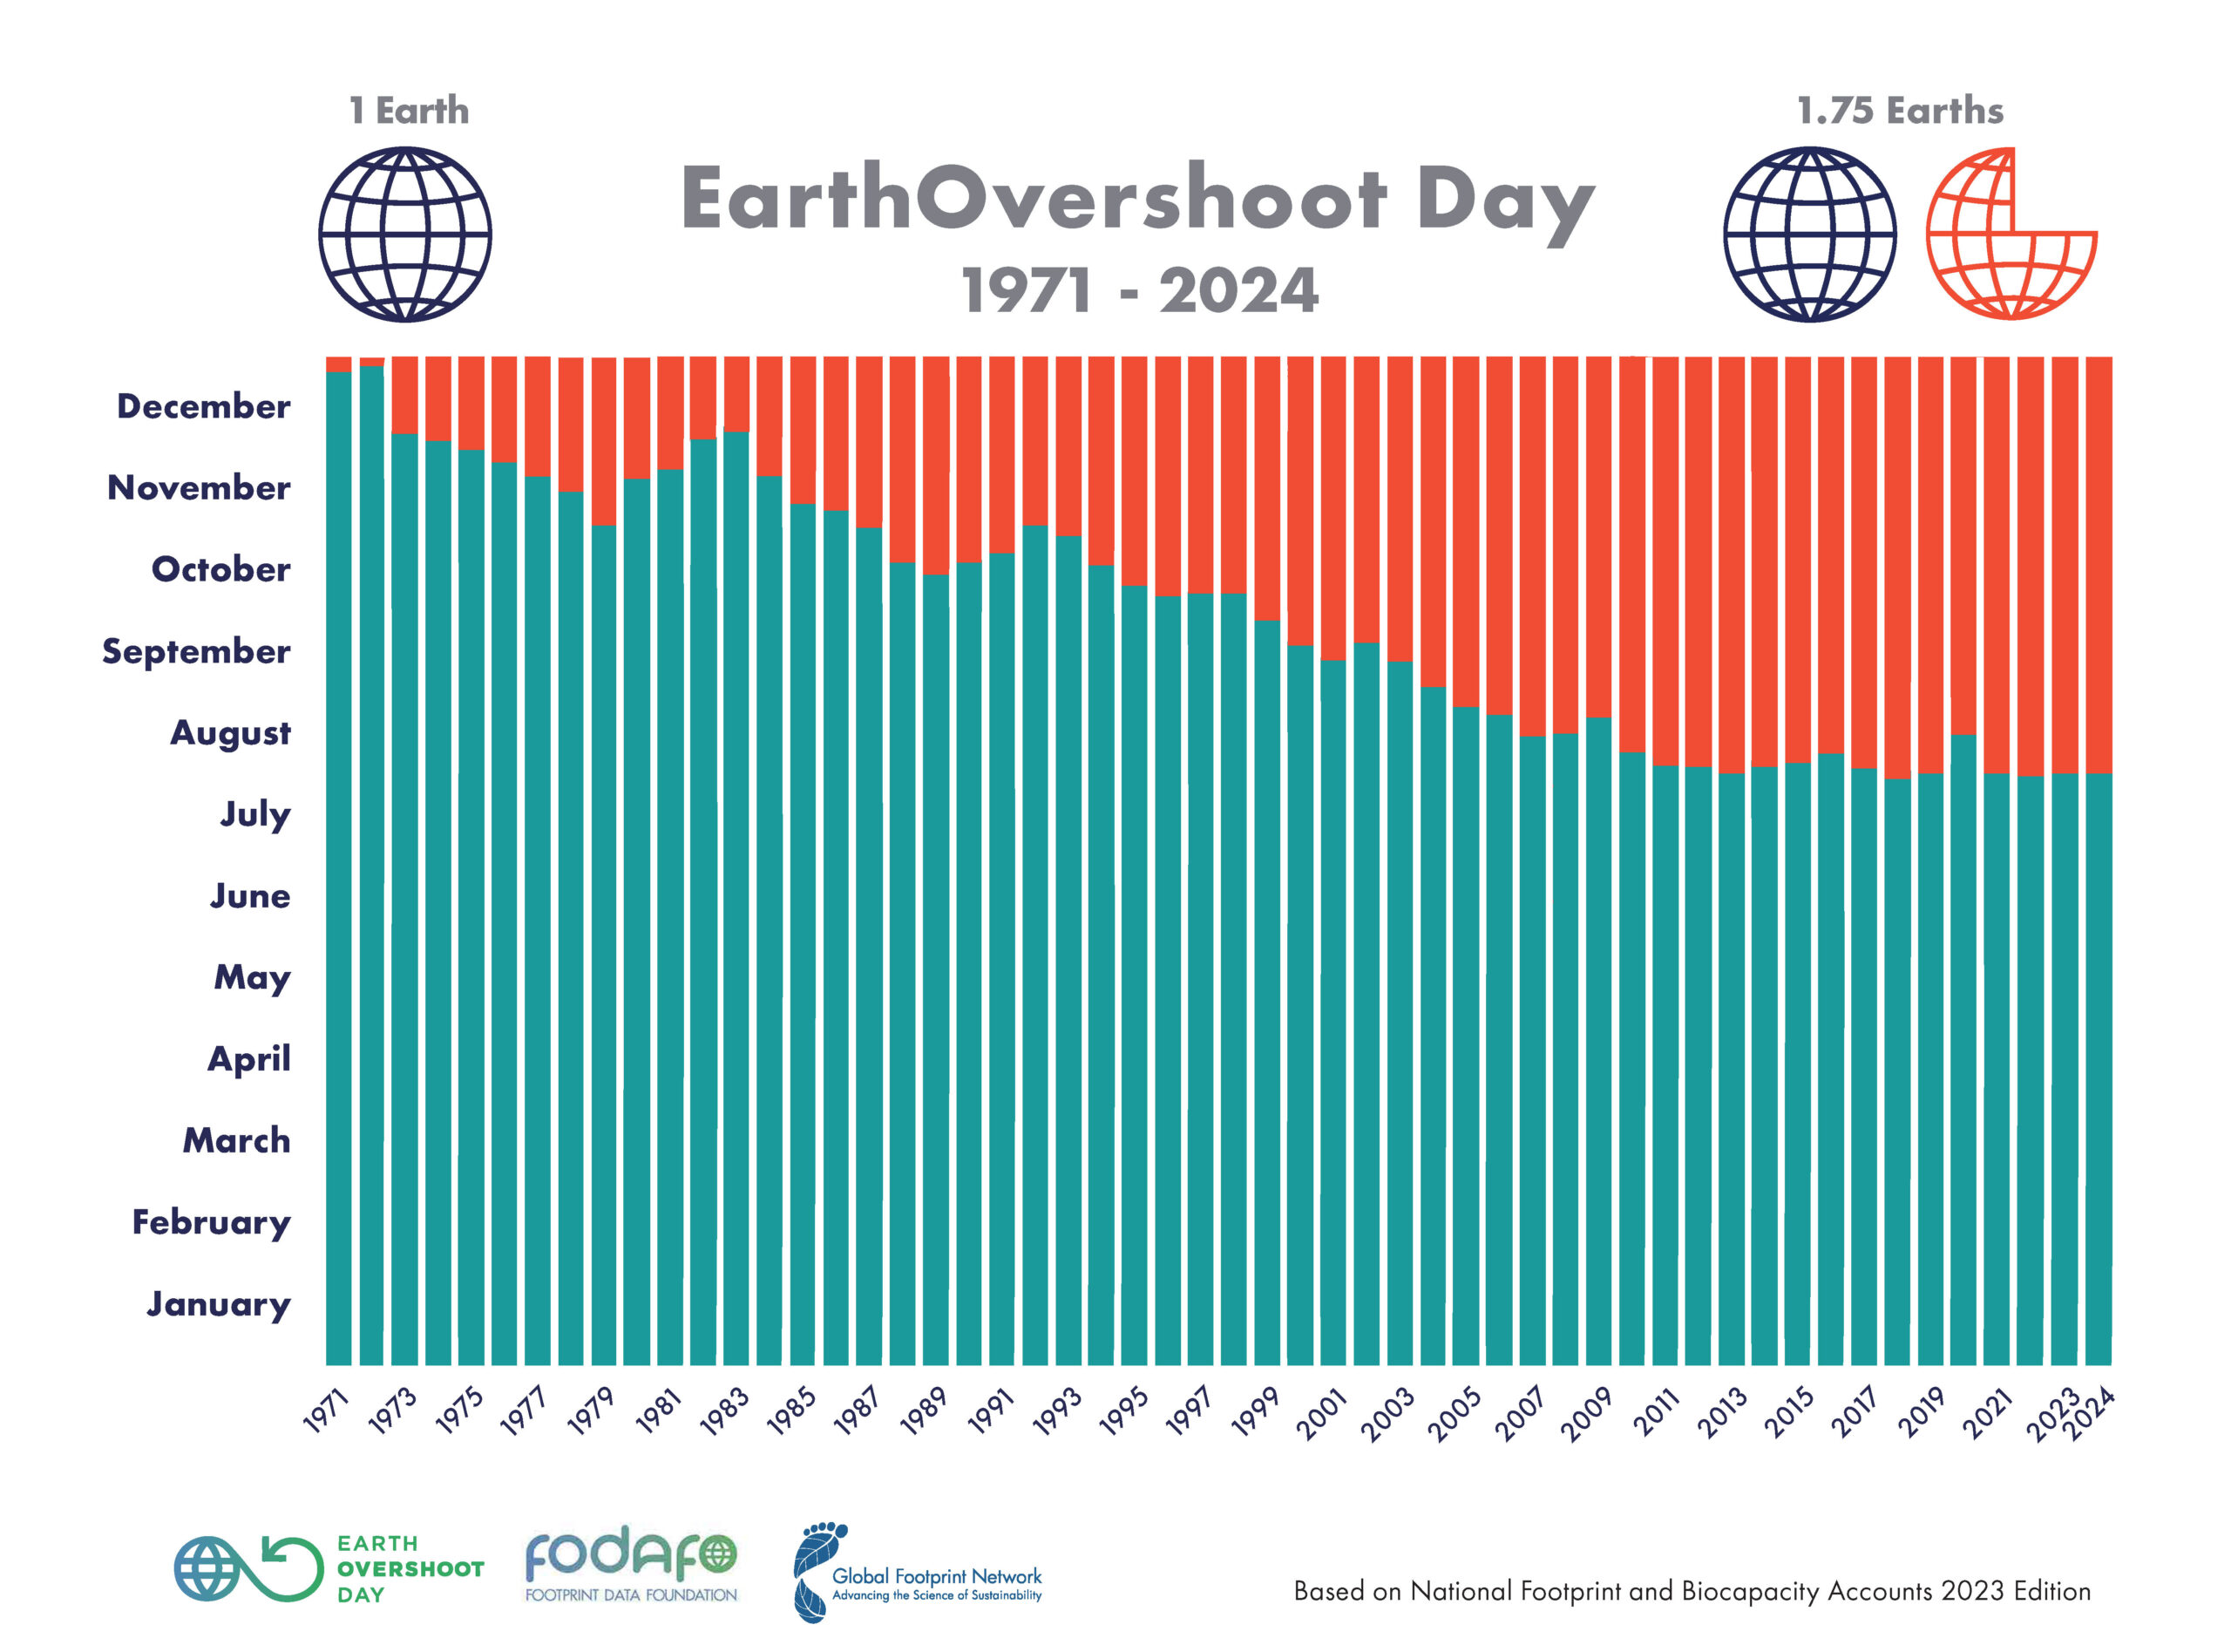
The Cost of Overshoot
Notes:
Overshooting Earth’s limits comes at a cost. We see it in deforestation, water shortages, declining fish stocks, and extreme weather. And this isn’t just theoretical—every year, Earth Overshoot Day comes earlier. In 1970, it fell in December. In 2016, it was August 5th. That means we used a year’s worth of resources in just 7 months.

Slide 8
One Earth is Enough
♻️ Energy efficiency
🍽️ Reduce food waste
🌳 Support conservation
Notes:
So what can we do? It starts with awareness. As individuals, we can reduce food and energy waste, choose more sustainable products, and support clean energy and conservation. As societies, we need policies that protect ecosystems, invest in renewables, and rethink what growth means. Sustainability isn’t about sacrifice—it’s about balance.

Slide 9

We only have one Earth. Living sustainably isn't just possible — it's necessary.
- Unknown
Notes:
We only have one Earth. Living sustainably isn’t just possible—it’s necessary. The future depends on how we act today. Thank you for listening.

